Slide 1
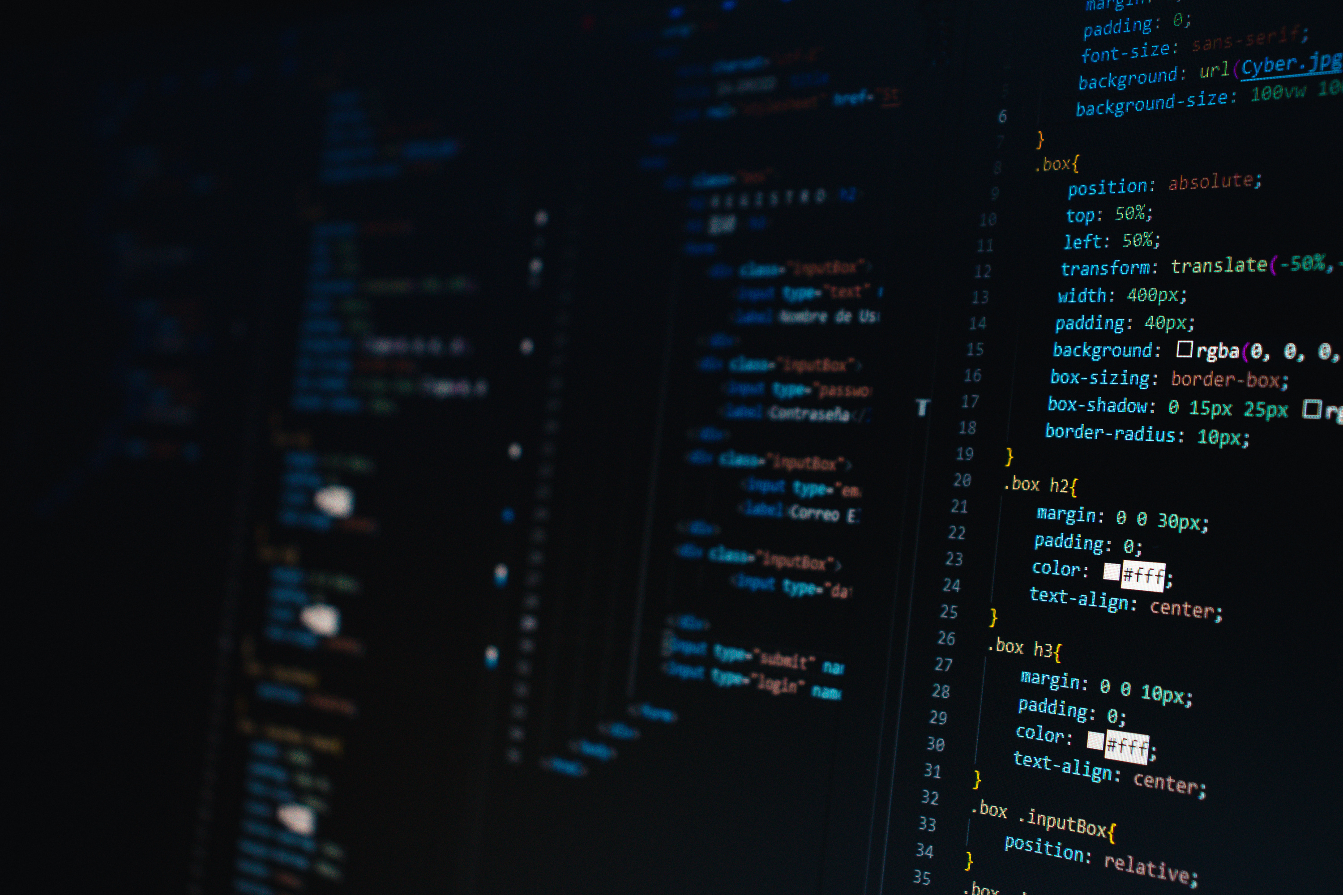
Modern Mini Market Web Application
(12429535) Yazeed Moayed Shamlawi
(12428337) Ezz Aldeen Rubeia
Instructor: Jehad Hamamreh

Slide 2

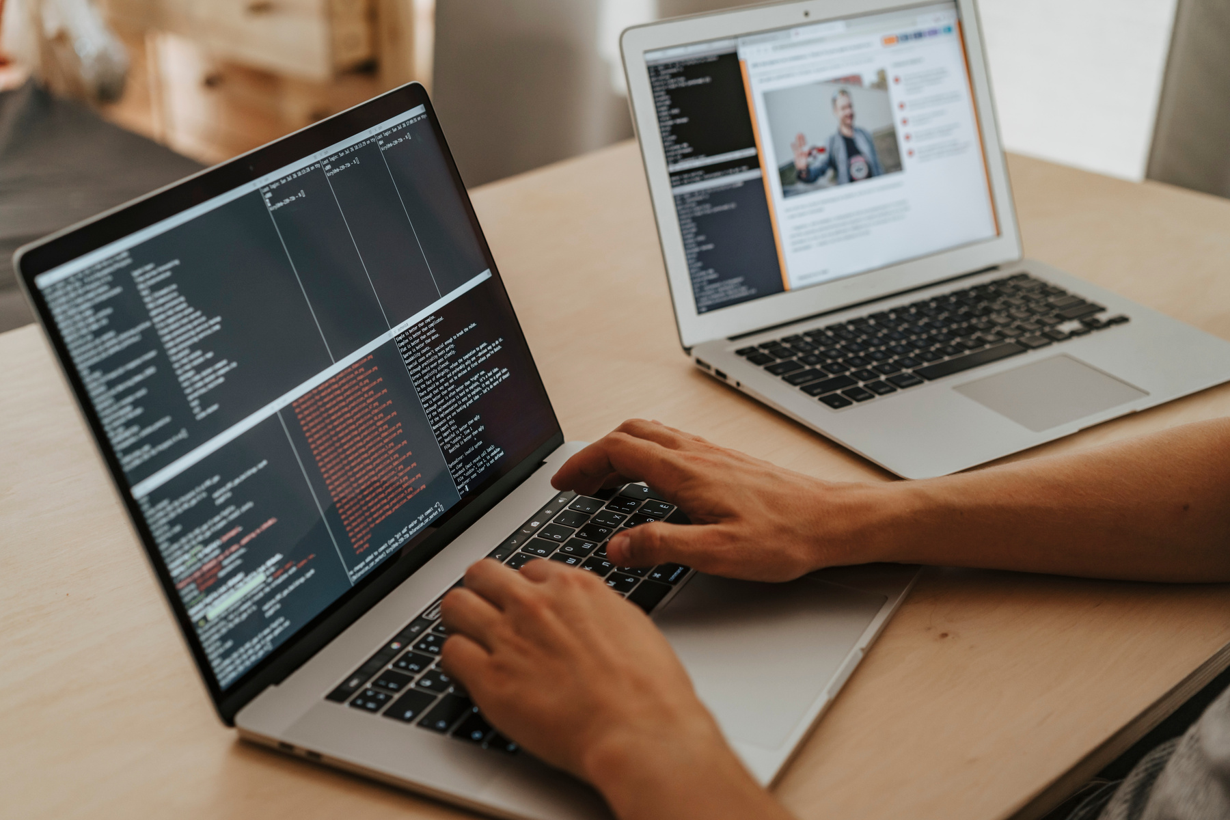

The Problem It Solved:
The Thing That My App Will Solve That Im Gonna Give It To A Shop To Use It And Make It His Own Webpage App To Put Its Products In It And Sell It To The Public.

Slide 3
PROJECT OVERVIEW
Mini Market Project is a web-based application that simulates a real online store.
The system allows users to:
Browse products.
Add items to a shopping cart.
Place orders using Cash on Delivery.
Track order status.
Administrators can:
Manage products.
View and update orders.
The project focuses on simplicity, clarity, and educational value.

Slide 4

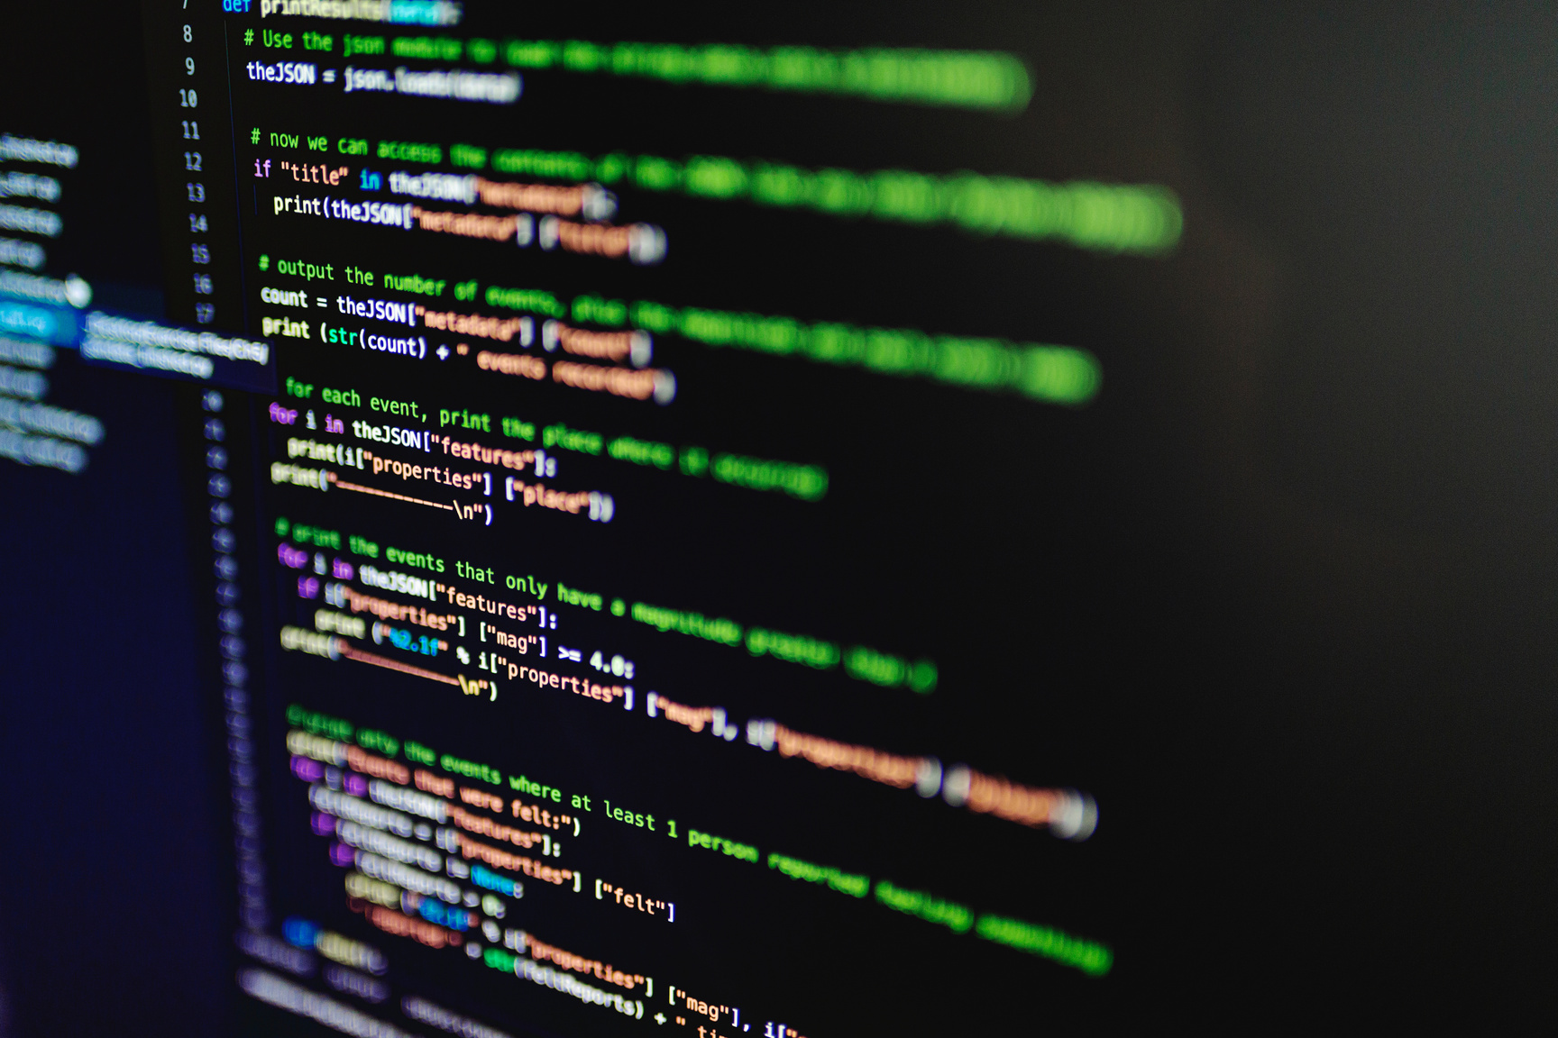
:⭐ Key Features of the System
This project includes several essential features that make it a complete mini e-commerce application:
1- User registration and login system.
2- Product browsing.
3- Shopping cart using session storage.
4- Order placement using Cash on Delivery.
5- Order tracking with Arabic status labels.
6- Detailed product view before purchase.
7- Secure database operations using PDO.
8- Product details page with description and color selection.
9- Product variants system (colors with individual stock).
10- Admin authentication using database-stored email.
PROJECT FEATURES

Slide 5

PROJECT OBJECTIVES
The Main Objectives Of This Project Are:
Build a functional mini
e-commerce system.
Implement session-based authentication.
Display order statuses clearly in Arabic.
Apply backend and frontend web development concepts.
Manage products and orders using a database.
Provide a clean and user-friendly interface.

Slide 6
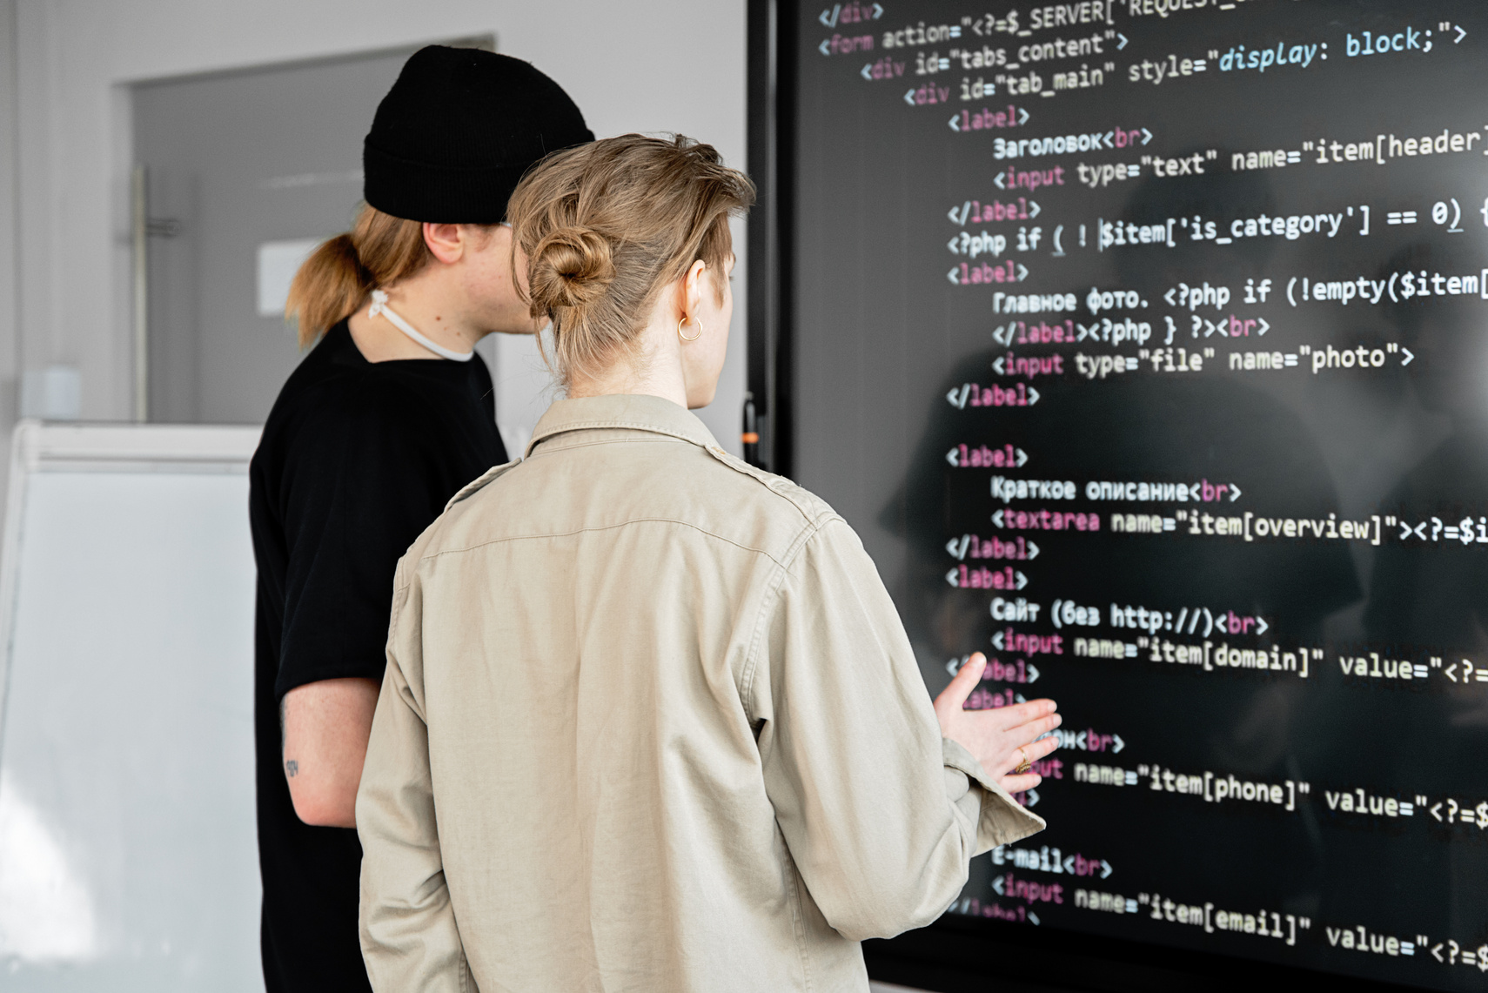
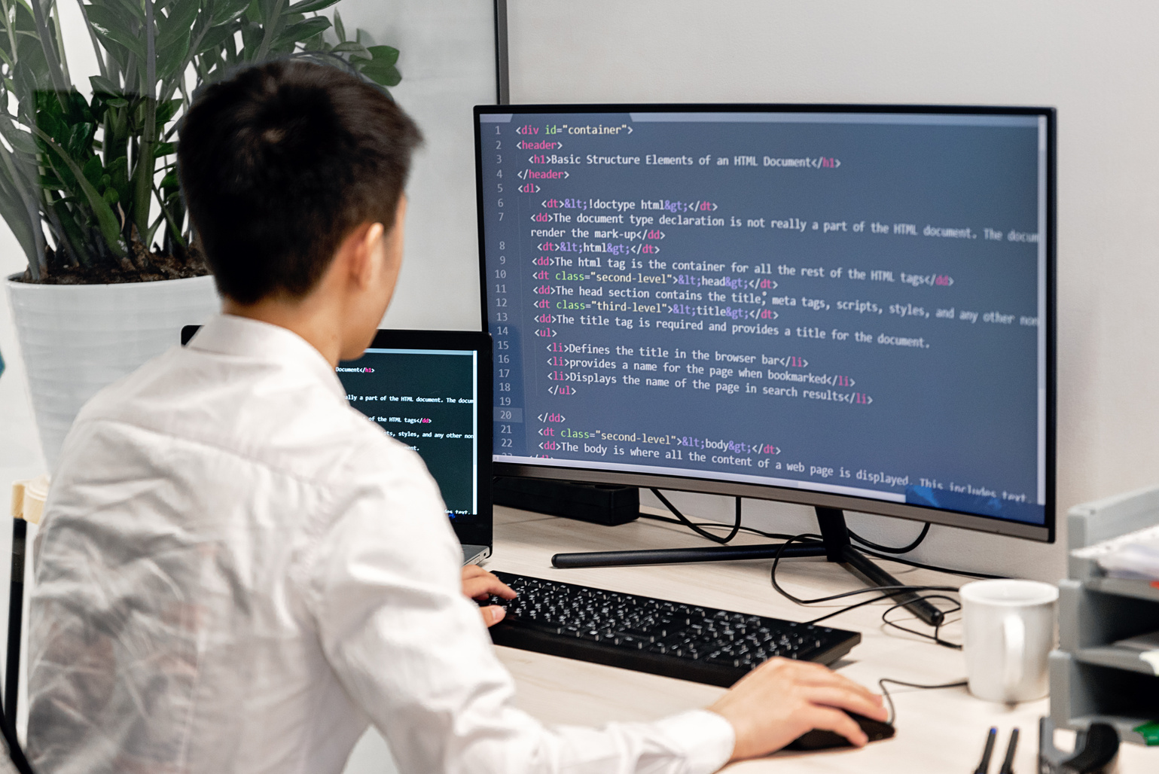
TECHNOLOGIES USED
Programming & Markup Languages:
1- PHP.
2- HTML.
3- CSS.
4- JavaScript.
Other Tools:
.PDO (Prepared Statements)
.Session Management
.Localhost (XAMPP / WAMP)
DataBase:
MySQL (Relational Database).

Slide 7

SYSTEM ARCHITECTURE
:The system follows a simple layered structure
:Presentation Layer
.(HTML, CSS, JavaScript)
:Logic Layer
.(PHP files for processing)
:Data Layer
Includes additional tables for product variants (colors & stock).
.(MySQL database)
Each layer is separated to improve clarity, maintainability, and security

Slide 8

USER ROLES
👤 Normal User
👨‍💼 Administrator
Login using authorized email stored in database.
Manage products (add, edit, delete).
Manage product colors and stock.
View and update orders.
Register and login.
Browse products.
Add products to cart.
Place orders.
View order history.
Track order status.

Slide 9

ORDER MANAGEMENT SYSTEM
:The system uses predefined order statuses
قيد التأكيد (Pending Confirmation).
قيد التنفيذ (Processing).
مكتمل (Completed).
ملغى (Cancelled).
:Each status
.Stored in the database
.Displayed in Arabic
.Shown with a color-coded badge
This improves clarity and user experience

Slide 10

BASIC SECURITY PRACTICES ARE IMPLEMENTED:
Session-based authentication.
Prepared SQL statements (PDO).
Input validation and sanitization.
Separation between user and admin access.
SECURITY & VALIDATION

Slide 11
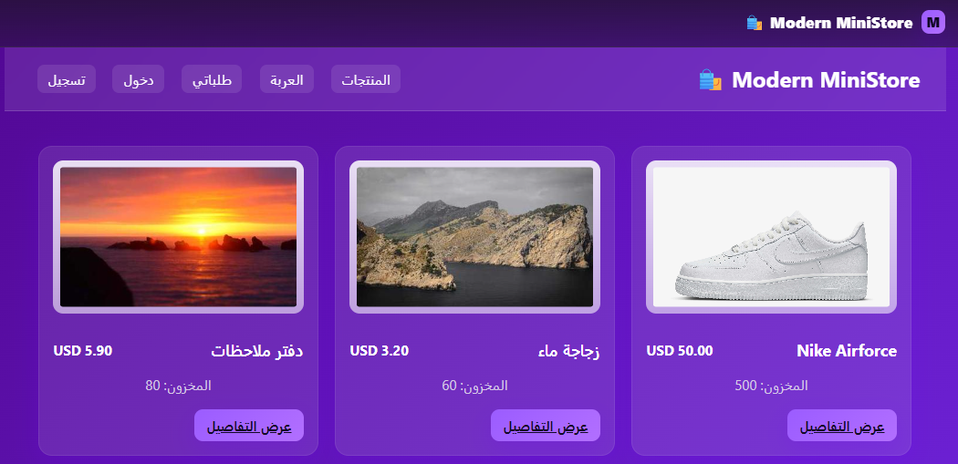
The Steps To Use The WebApp
First You Will See The Main Page And You Can See The Products Detailed And Normal And Inorder to buy them u have to register or login.

Slide 12
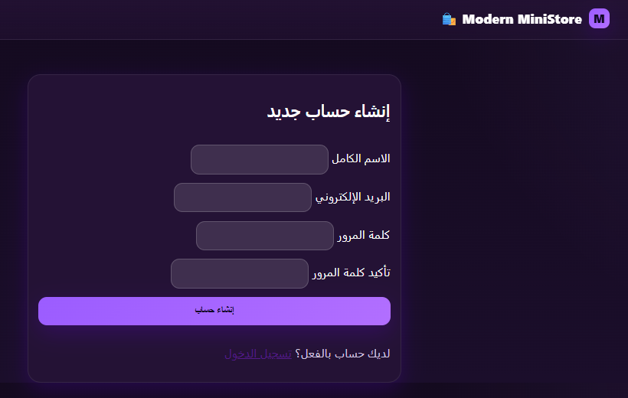
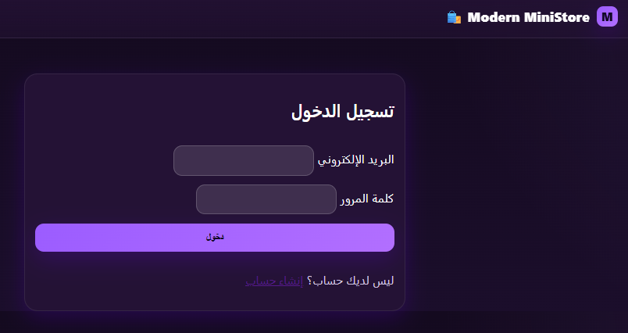
The Problem It Solved:
Then The User Can Register Or Login If He Had An Account Before In The App:

Slide 13
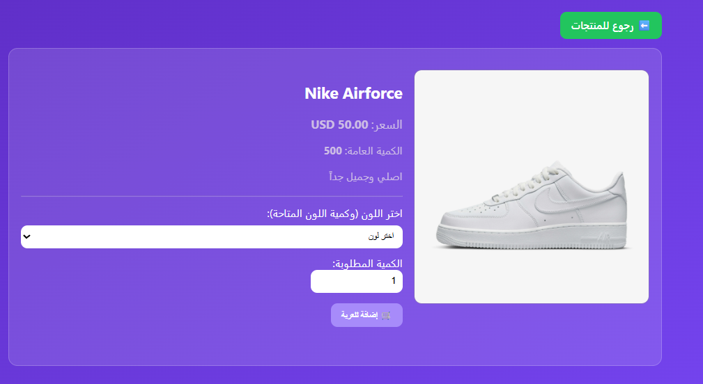
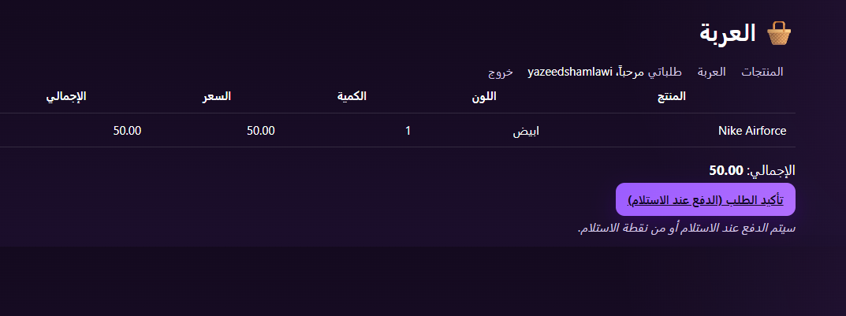
The Problem It Solved:
Here You Will Add The Product Like You Want To The Cart:

Slide 14
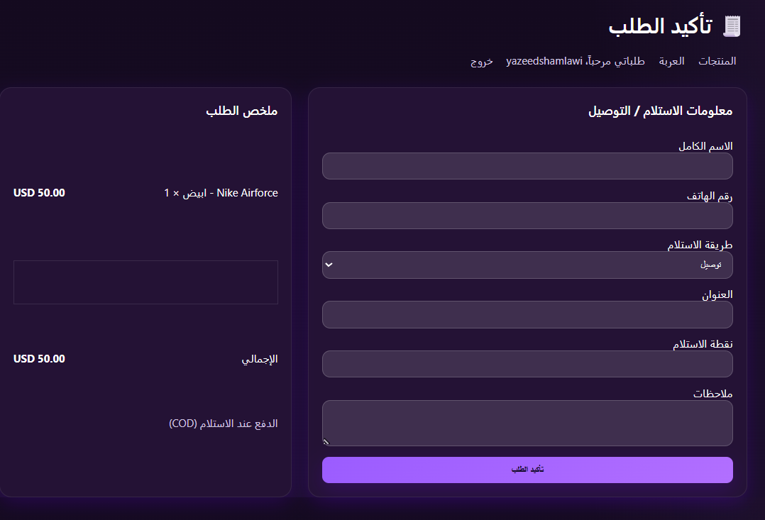
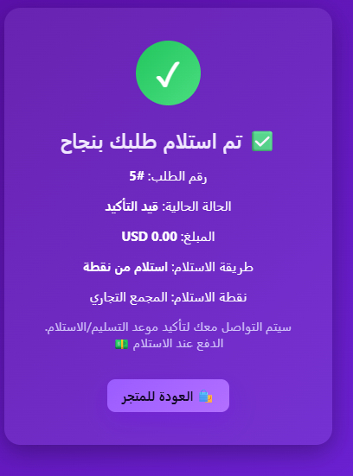
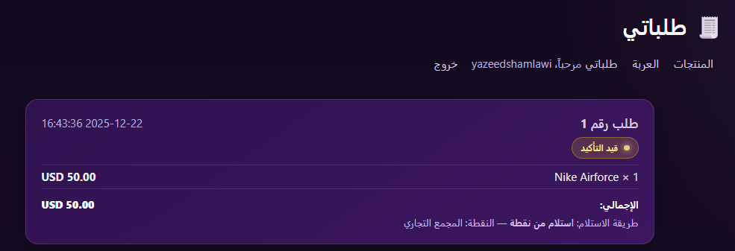
The Problem It Solved:
Here You Will Put Your Information For The Approvement And Then You Will See A Thank You Picture And Then You Will See Your Orders:

Slide 15
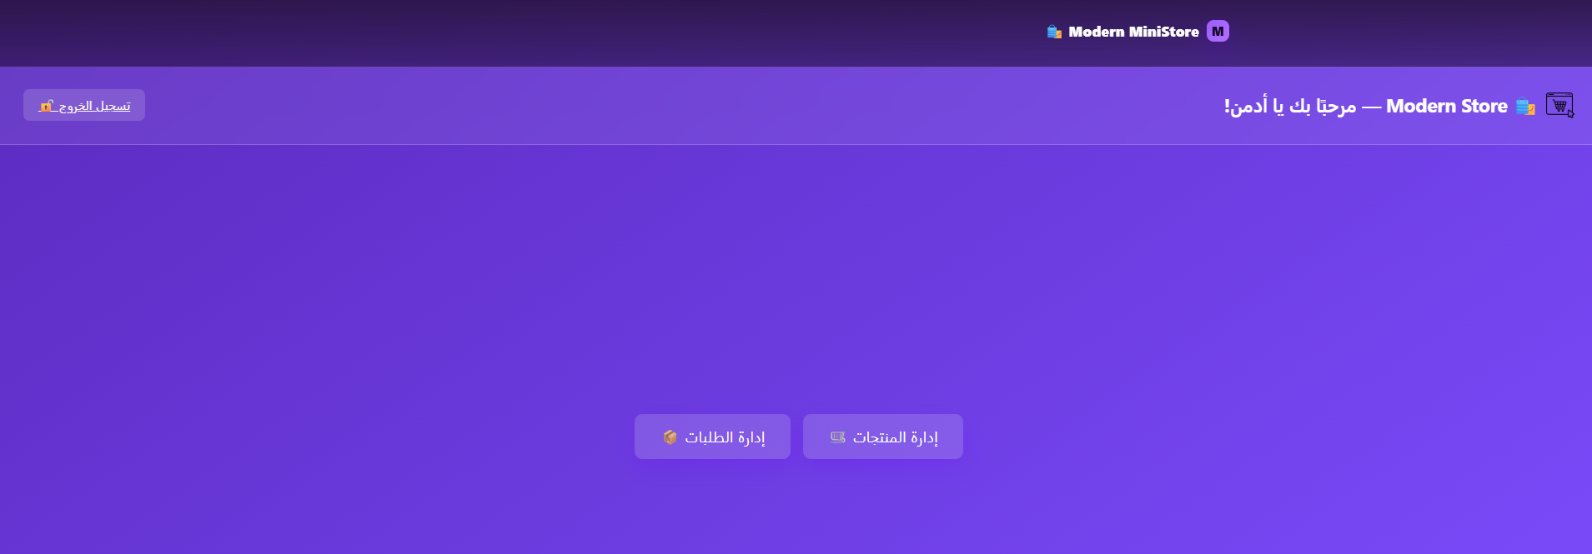
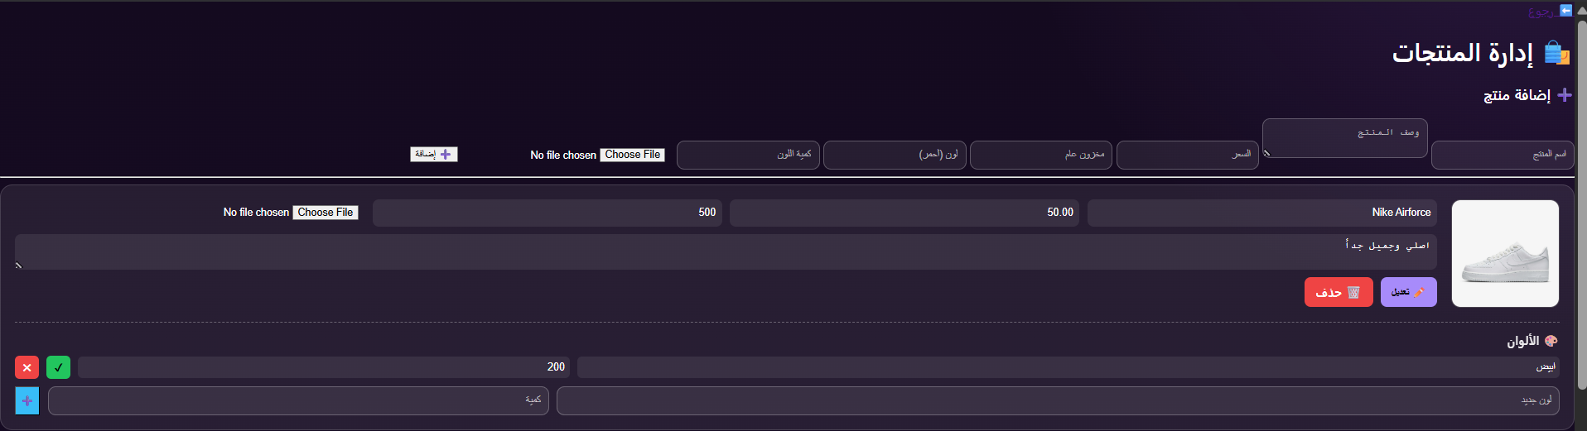
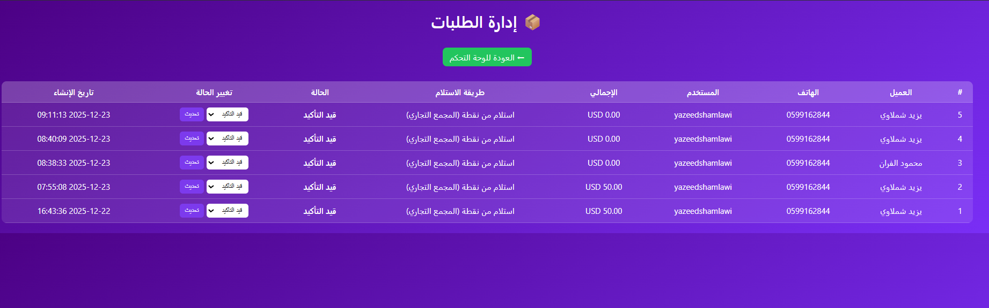
The Problem It Solved:
And Here The Admin Dashboard You Can Edit/Delete/Update The Products And You Also Can Update The Status Of The Orders:

Slide 16


Arowwai Industries
The Mini Market Project demonstrates:
Strong understanding of web development fundamentals.
Practical use of PHP and MySQL.
Clean system organization.
Realistic e-commerce workflow.
User-friendly Arabic interface.
PROJECT CONCLUSION

Slide 17

THANK YOU

